Slide 1
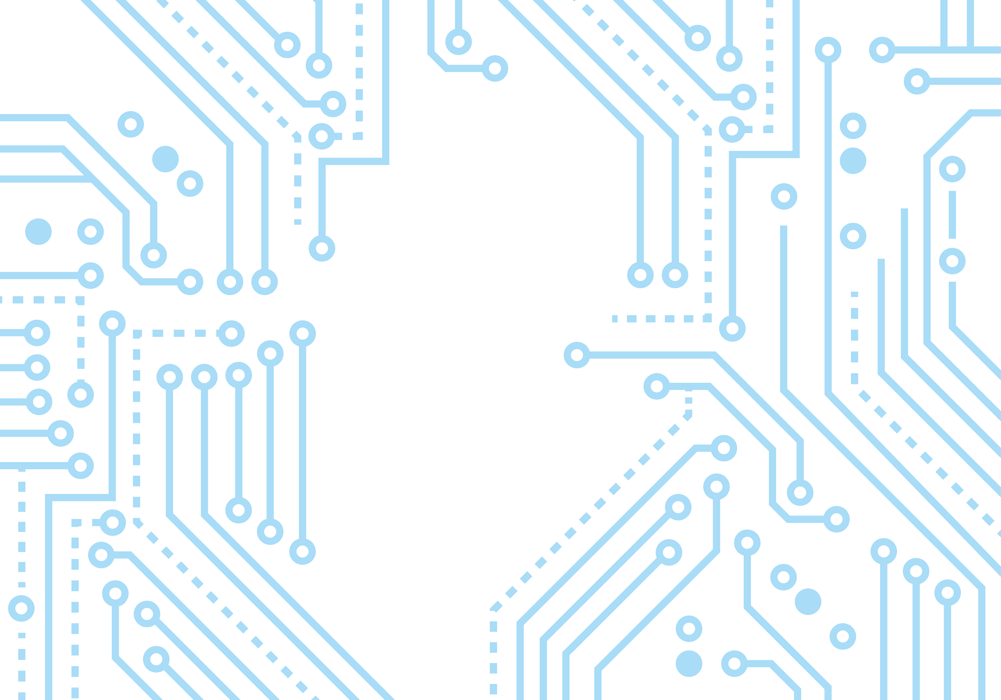
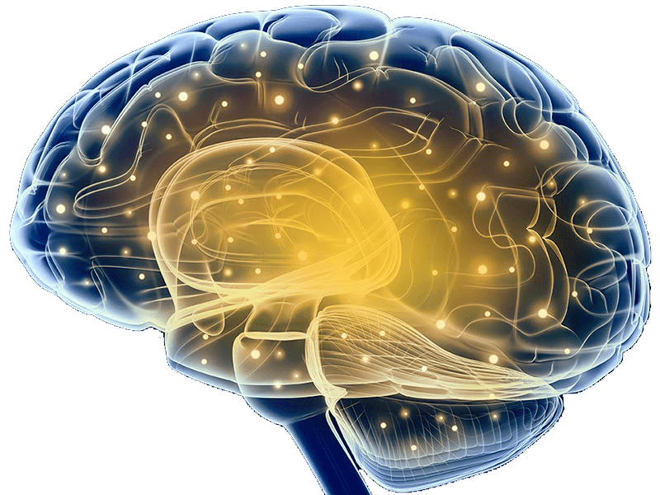
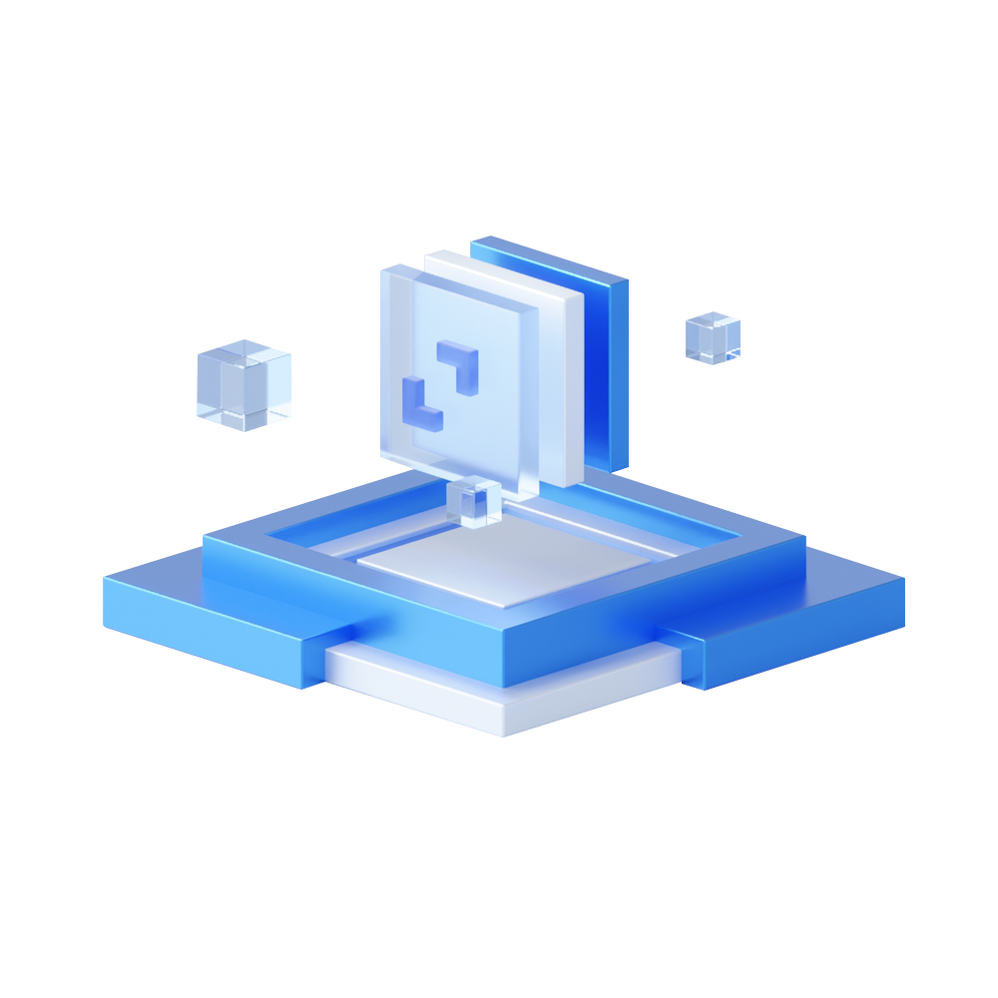

Slide 2
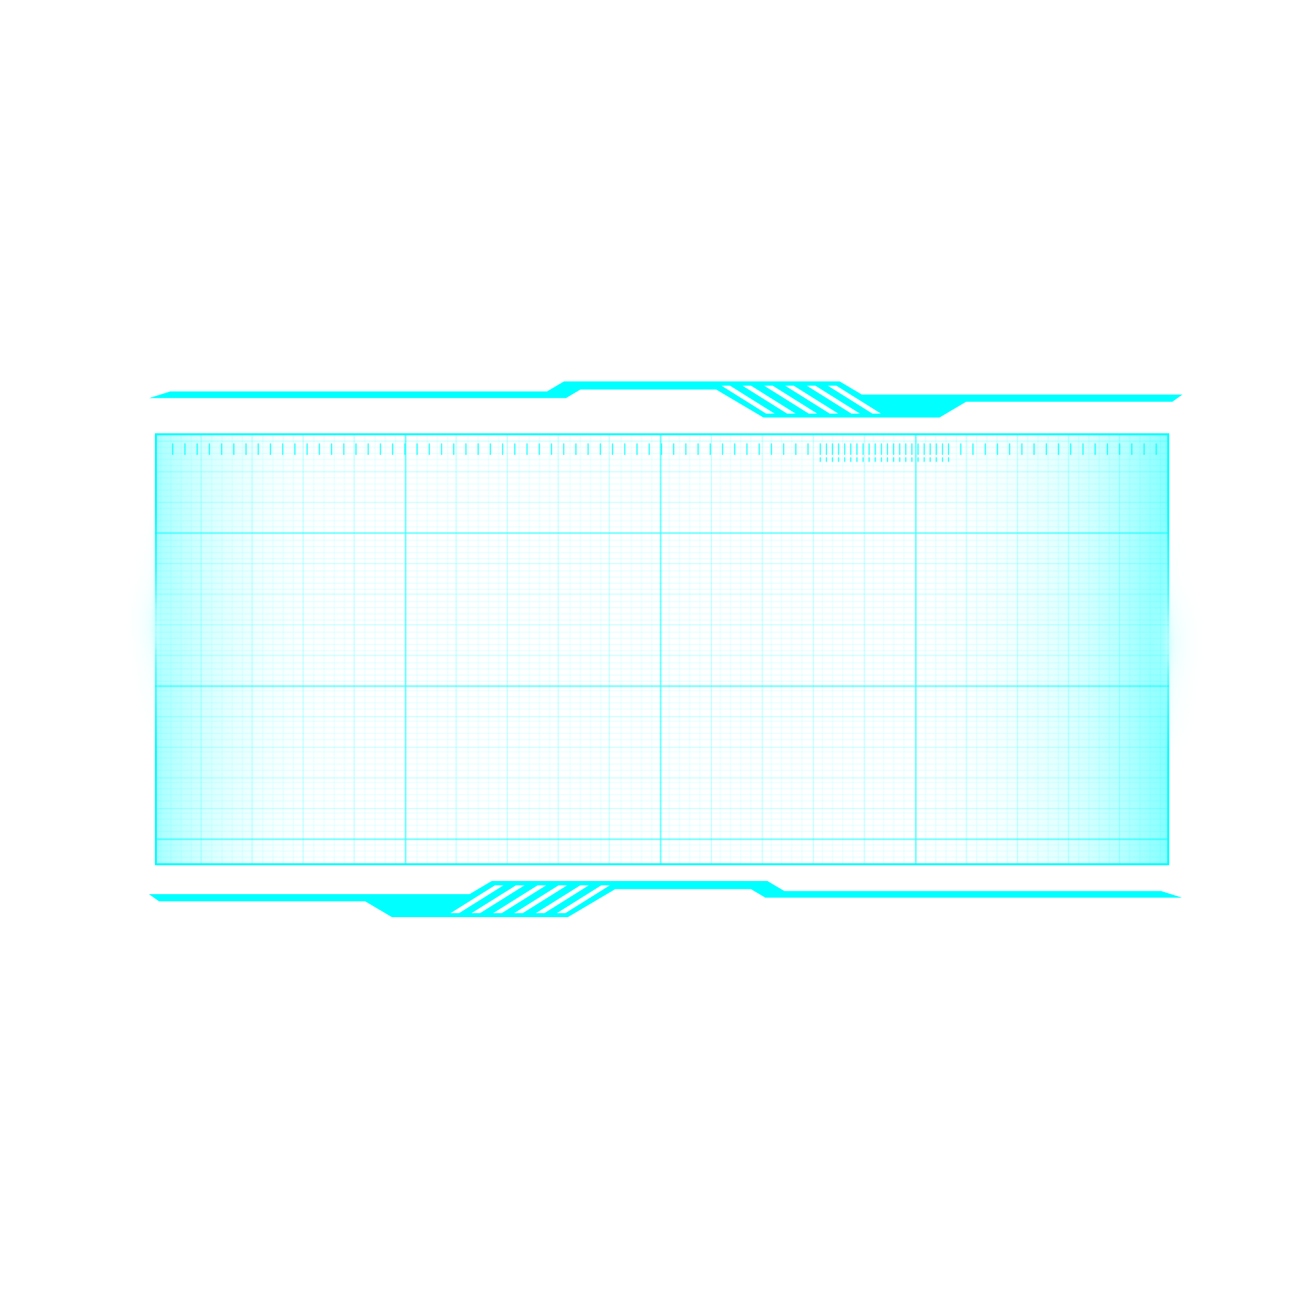



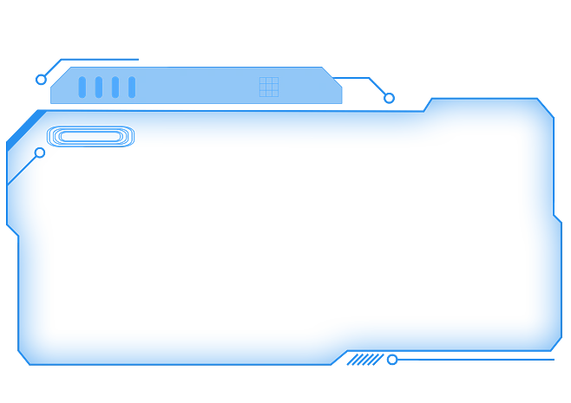
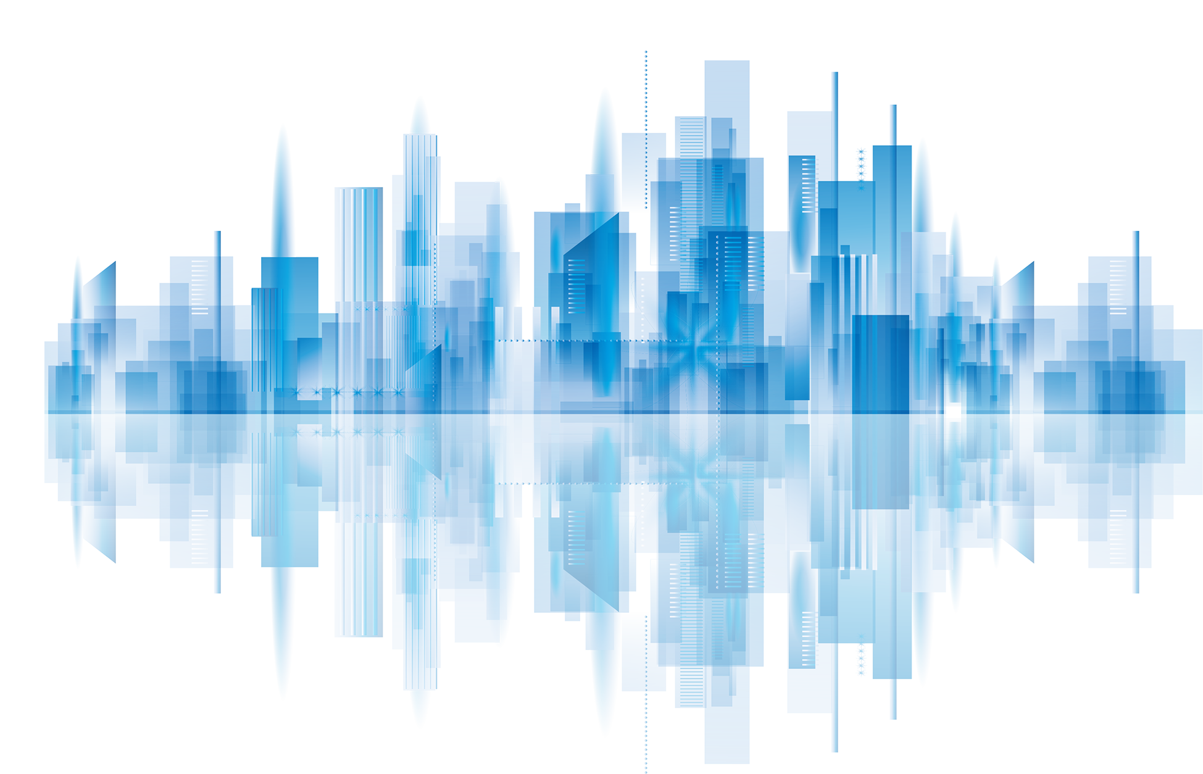
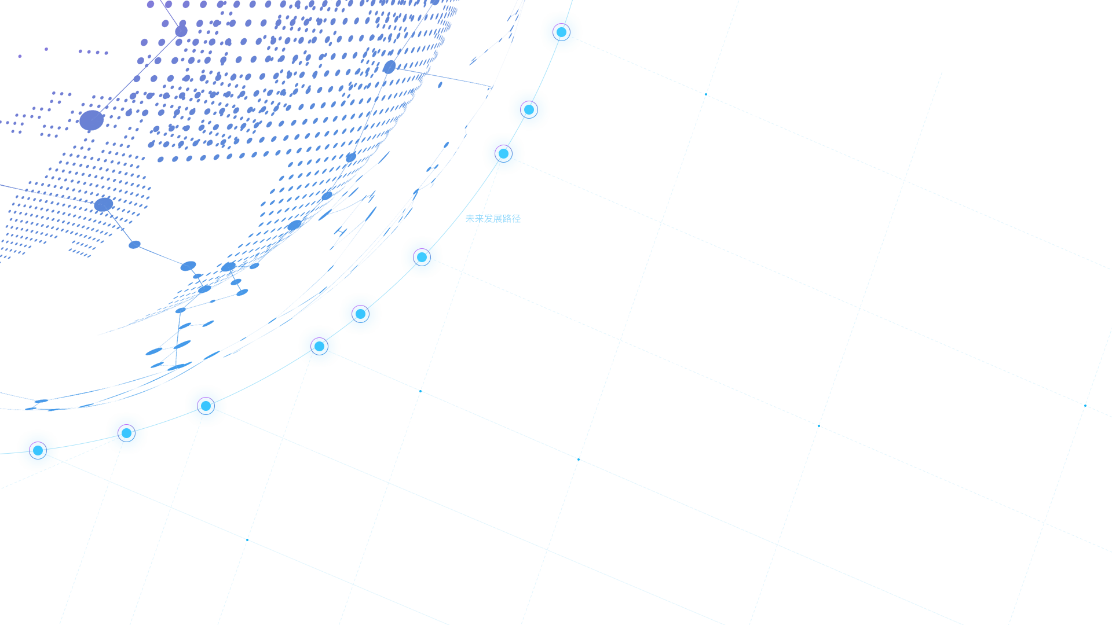
Chips and Brains
Three Minute Speech Before English Class - Mao Shumo

Slide 3
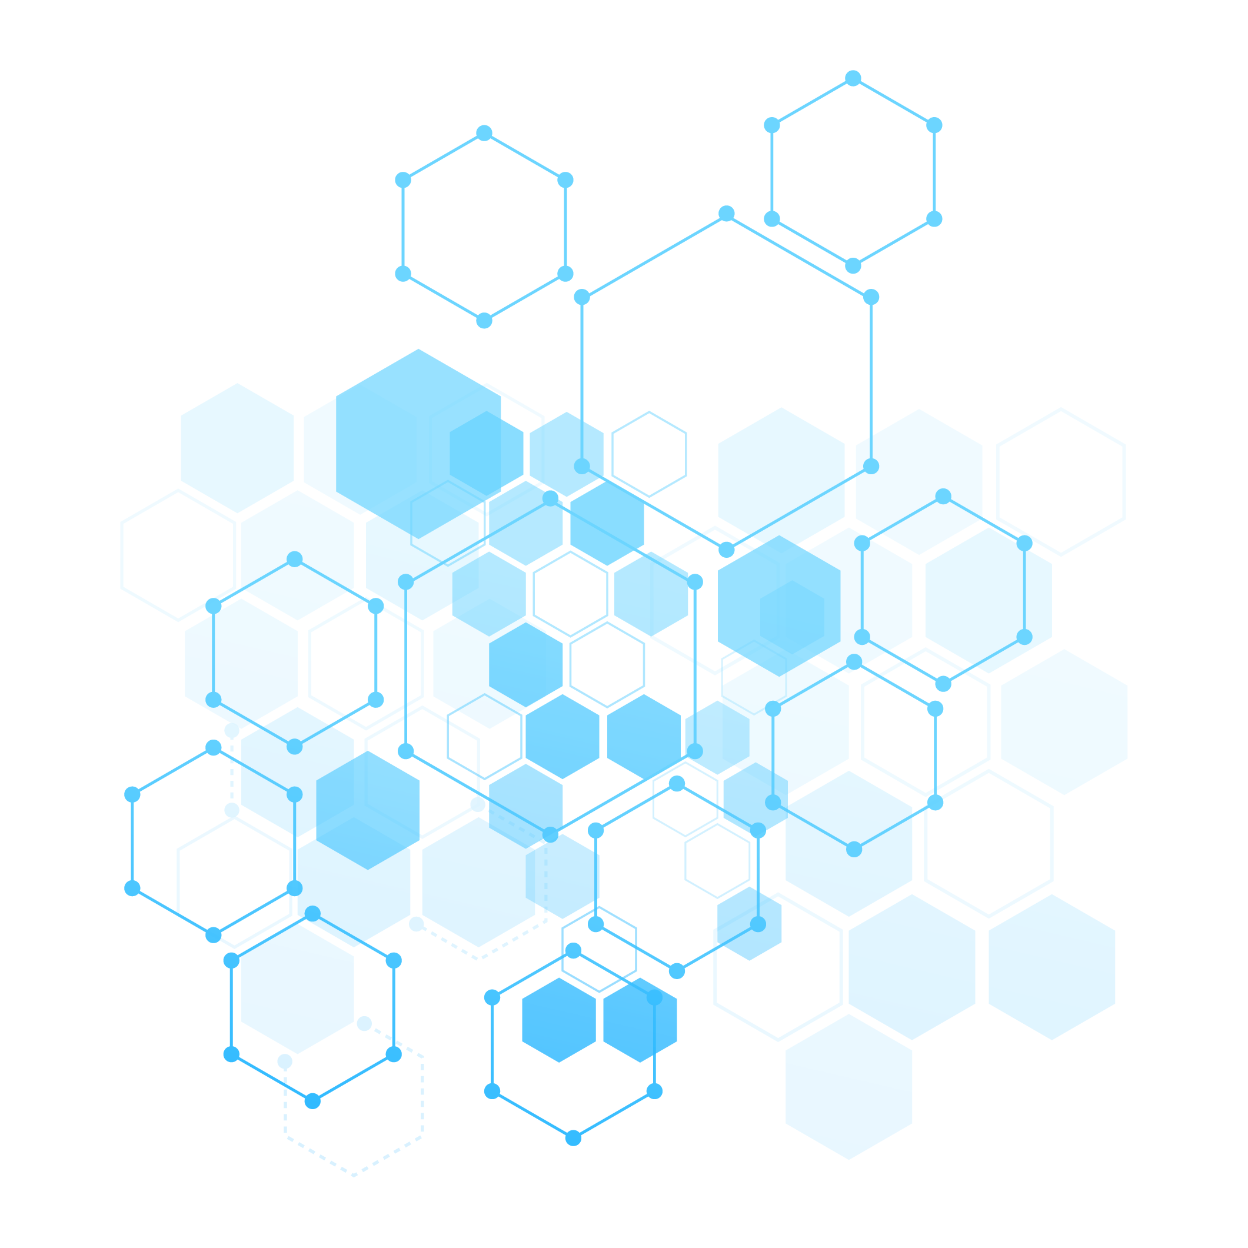
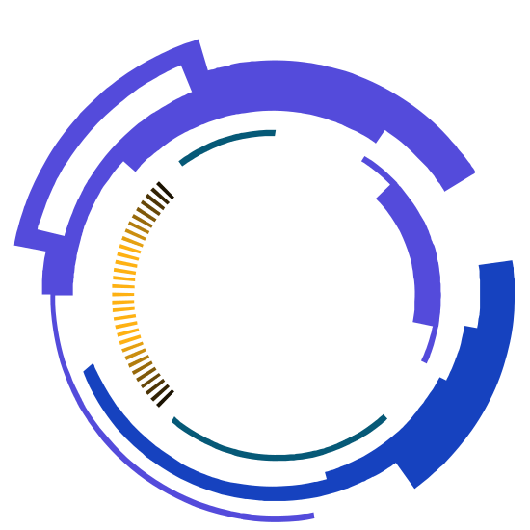
Tip: Technological (adj)技术的 development发展chip芯片 brain大脑
1
The state of the technology in 2021

Slide 4
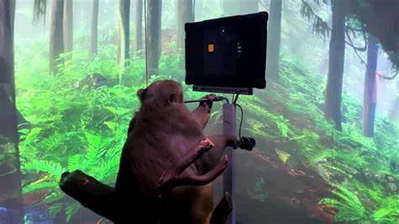
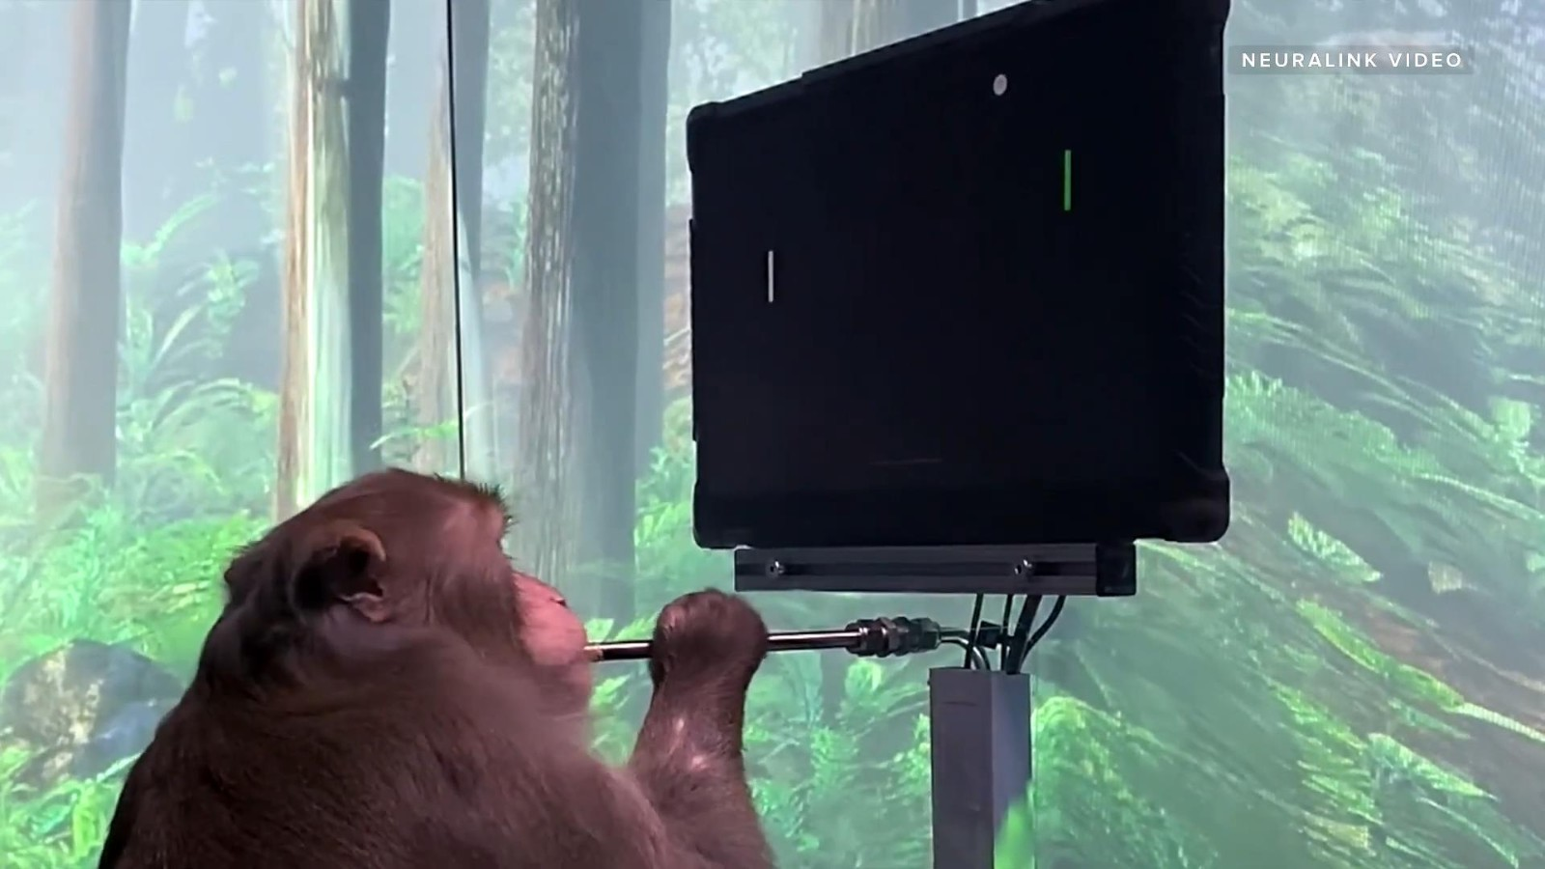


The state of the technology in 2021
Tip: Technological (adj)技术的 development发展
First, let's look at some pictures.
In these pictures, a monkey is playing computer games with his mind. It's very amazing!
1

Slide 5
The state of the technology in 2021
Tip: implanted植入 chip芯片 mind意念
These two pictures are on fire in 2021
The monkey in these pictures is named Pager, and a company called Neuralink implanted a chip into his brain, which allowed Pager to play games with his mind.

Slide 6


The state of the technology in 2021
Tip: analyse分析 pros and cons利与弊
…
2
The news got a lot of attention at the time, and many people began to analyse the pros and cons of the technology
These two pictures are on fire in 2021
The monkey in these pictures is named Pager, and a company called Neuralink implanted a chip into his brain, which allowed Pager to play games with his mind.

Slide 7
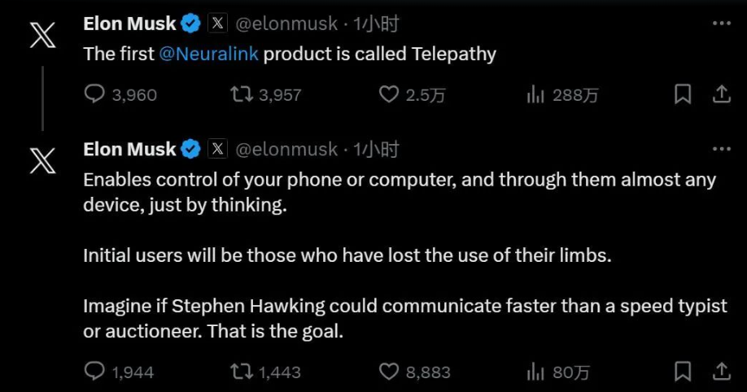

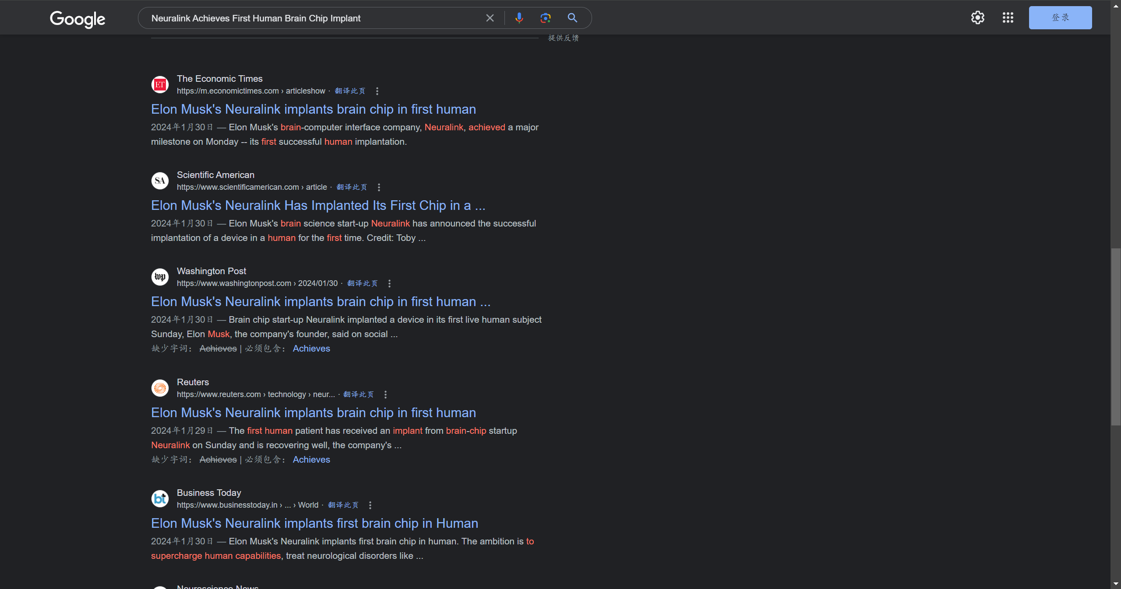
Tip: nowadays如今
2
Nowadays

Slide 8

Nowadays
Tip:fires up again再次火爆
Neuralink fires up again on 31 January 2024
2

Slide 9



Nowadays
Tip:founder创建者 release发布 completed完成 recovering恢复
Neuralink fires up again on 31 January 2024
Elon Musk, founder of Neuralink, releases that the company has completed the first human brain chip implant and the implantee is now recovering well

Slide 10

(g
Nowadays
Tip:valued值钱(估值） electronics电子学（设备）
Elon Musk, founder of Neuralink, releases that the company has completed the first human brain chip implant and the implantee is now recovering well
Neuralink fires up again on 31 January 2024
More Informations
Musk said that Neuralink's first product was named Telepathy.
In June 2023, Neuralink was valued at more than $5 billion ( About Rs. 35,717 million)
The implanted person can act on the electronics with his mind.
3

Slide 11
Tip: thoughts想法
3
My Thoughts

Slide 12

My Thoughts
Tip: analysing分析regain恢复disabilities残疾
I'll also be analysing this in terms of pros and cons
Benefits:
This technology can help blind people regain their sight and help people with disabilities use electronics
The bad:
This technology could be used by the bad people
3

Slide 13
T
The end
Benefits:
This technology can help blind people regain their sight and help people with disabilities use electronics
Tip: analysing分析regain恢复disabilities残疾misused滥用，误用raising unprecedented dangers带来前所未有的危险
My Thoughts
The bad:
The technology could be misused, raising unprecedented dangers
I'll also be analysing this in terms of pros and cons

